Slide 1
Facts and Fiction about GMOs
Richard J. Roberts
BIO Africa Convention
Zoom August 25th 2020

Slide 2
155 Nobel Laureates call for science honesty about GMOs
We call on the Green parties to stop scaring the public by pretending that GMO foods must be banned because they are dangerous.
There is simply no evidence for this

Slide 3
Food means Agriculture
For 10-12,000 years we had been using crude genetics
But in the 1980’s we learned how to be precise

Slide 4
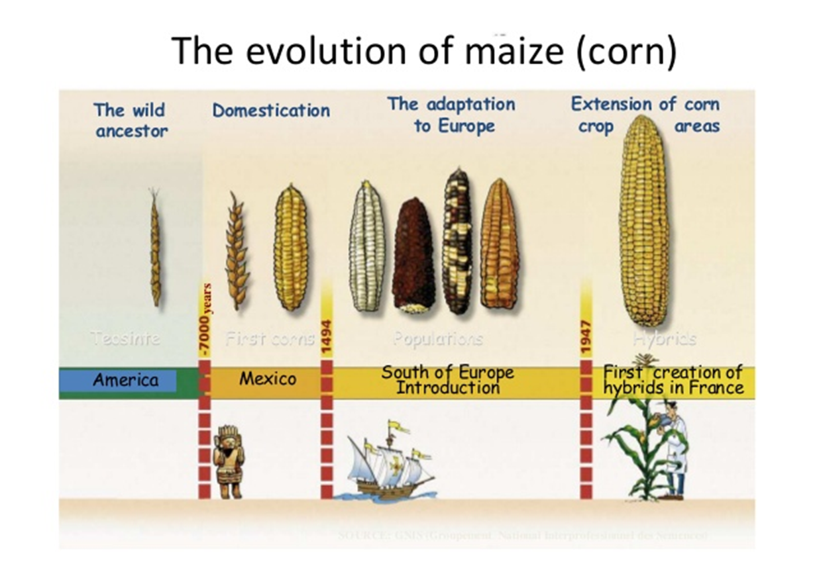

Slide 5
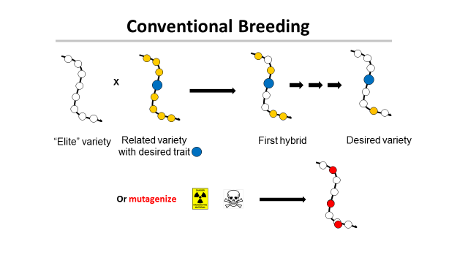
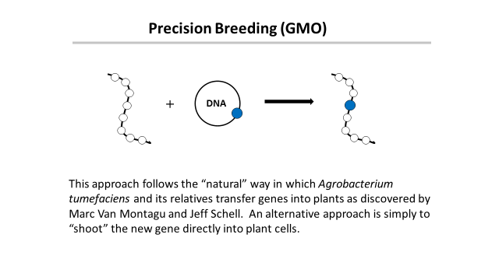
‘This is safe!’
← Greenpeace says →
‘This is dangerous!’

Slide 6
Traditional versus precision methods
I want to move a GPS system from my old car into my new one
Should I disassemble two cars, mix up the parts and then “select” for the one with the GPS, ignoring what else it might have picked up?
Or should I take the GPS from one car and move it to the other?

Slide 7
Traditional versus precision methods
If I take a GPS from an airplane
will the new car fly?

Slide 8
Genetic Modification refers to a method
But what is important is the
PRODUCT
not the
METHOD
This is just as true for traditional breeding

Slide 9
Food in Developing Countries
In the USA and Europe big agricultural companies have
invested heavily in traditional breeding to improve crops
Why was there no such effort
in developing countries?
Precision breeding (GMOs) can help
Why does Europe claim this is
dangerous and try to block it?

Slide 10
The “Real” Problem in Europe
Europeans did not want US companies to control their food
How can that be prevented?
Ban Monsanto and other big US agri-businesses

Slide 11
The Green Parties Opportunity
Assert that precision breeding might be dangerous!
The politicians and the green parties will protect
you from this risk by banning growing GMOs
Best of all
This has no economic consequence for Europe !

Slide 12
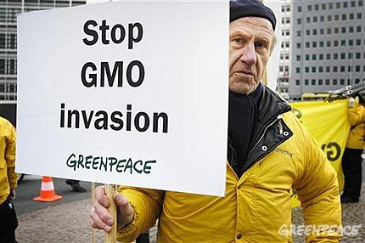
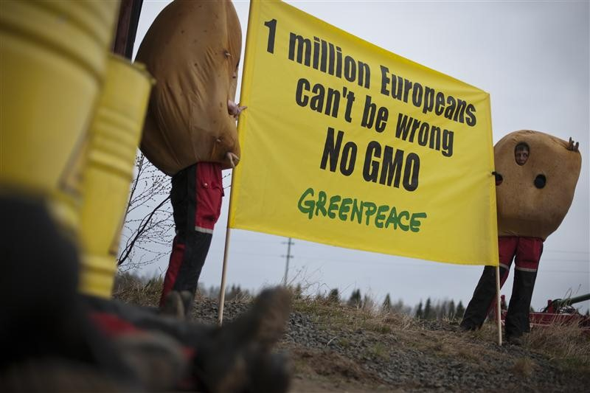
The tragic consequences
Not content with blocking precision agriculture in Europe many politicians and NGOs like “Greenpeace” and “Friends of the Earth” are now spreading their message to the developing countries

Slide 13
A case study
Vitamin A-deficiency
Global population mortality (in millions)
Vitamin A-deficiency | 1.9-2.7
HIV/Aids | 1.7
Tuberculosis | 1.4
Malaria | 0.75
*Courtesy of Ingo Potrykus
Notes:
Golden Rice and Beyond – challenges of a humanitarian GMO project.

Slide 14
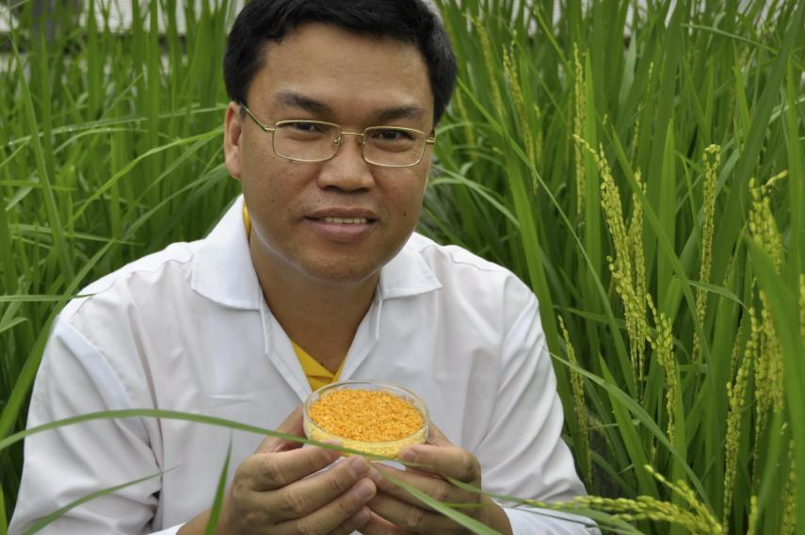
Golden Rice
A new source of Vitamin A
Suggested by Peter Jennings in 1984
Brought to fruition by
Ingo Potrykus, ETH Zurich
Peter Beyer, U. Freiburg
Tony Alfonso
Courtesy of Ingo Potrykus

Slide 15
Golden Rice
Became a reality in February, 1999.
Could have begun the improvements necessary for commercial production in the field within 2-5 years
But it’s a ‘GMO’ and only now will it soon be available
Multiple years of delay due to regulation and opposition.
Courtesy of Ingo Potrykus
Notes:
Golden Rice and Beyond – challenges of a humanitarian GMO project.

Slide 16
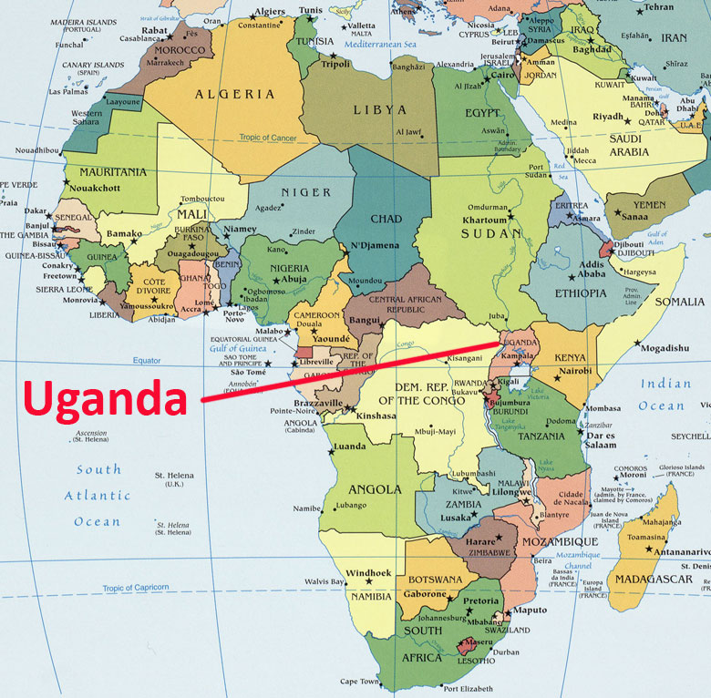
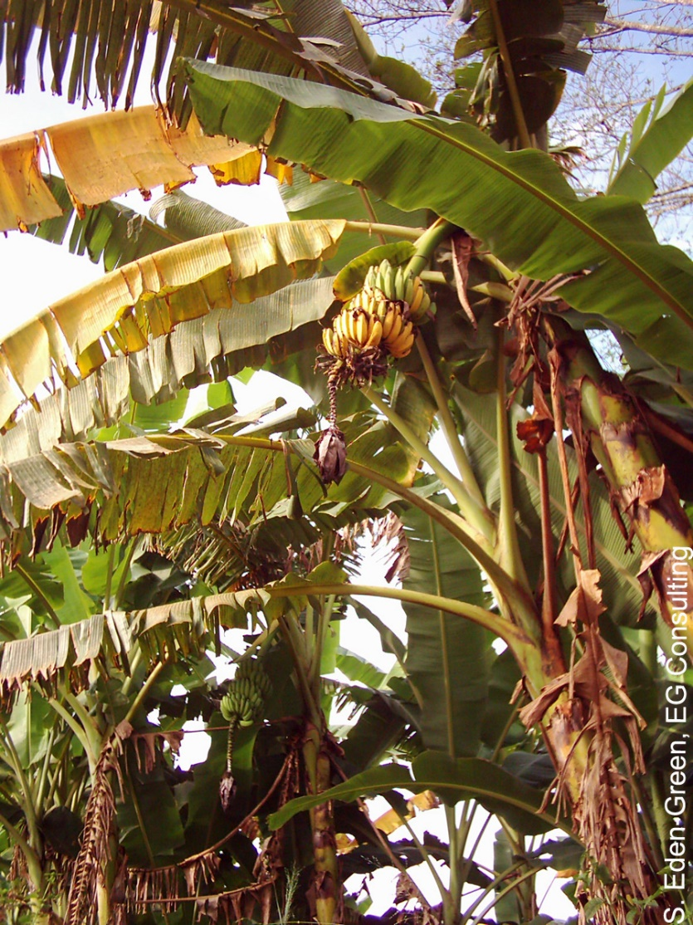
The Banana Problem
Xanthomonas wilt
No natural varieties are resistant so no
traditional breeding solution
BUT
Sweet pepper is resistant to Xanthomonas campestris and two genes are known that mediate this resistance. Using precision techniques these genes have been transferred to banana and these modified bananas are now beginning field trials.

Slide 17
Casava suffering from brown streak disease
In 2020 scientists in Kenya and Uganda have engineered a CBSV resistant variety!

Slide 19
Bangladesh: Bt eggplant
Slide courtesy of Arif Hossain/Cornell Alliance for Science

Slide 20
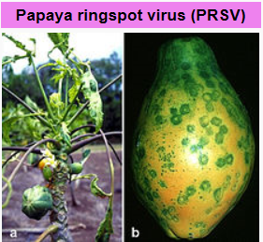
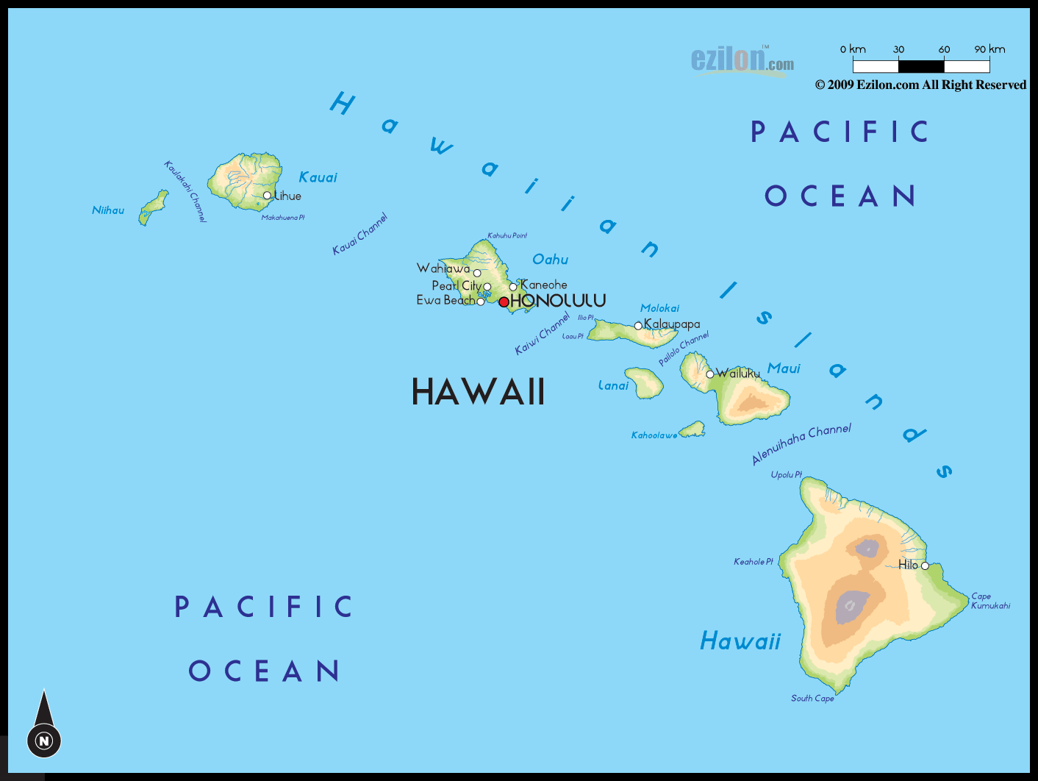
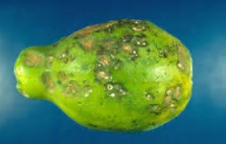
Hawaiian papayas
Almost a disaster

Slide 21
GMO Papaya saves the Hawaiian crop
In the 1990s, Hawaiian papaya trees were plagued by the ringspot virus which decimated half the crop in the state.
In 1998, Dennis Gonzales from the University of Hawaii developed a transgenic fruit called Rainbow papaya, which is resistant to the virus.
Now 77 percent of the crop grown in Hawaii is genetically engineered and being eaten in the USA.
But in Thailand this solution is banned

Slide 22
Science Facts
For developed countries food is not a problem.
We must never forget the consequences of our actions for the developing countries
We need more science in politics
And less politics in science

Slide 23
Food choice is a luxury of the developed world
If you don’t want to eat foods derived by GM techniques, then don’t. It’s your choice
But don’t pretend such foods are dangerous
If anything
They are probably safer than traditional foods

Slide 24
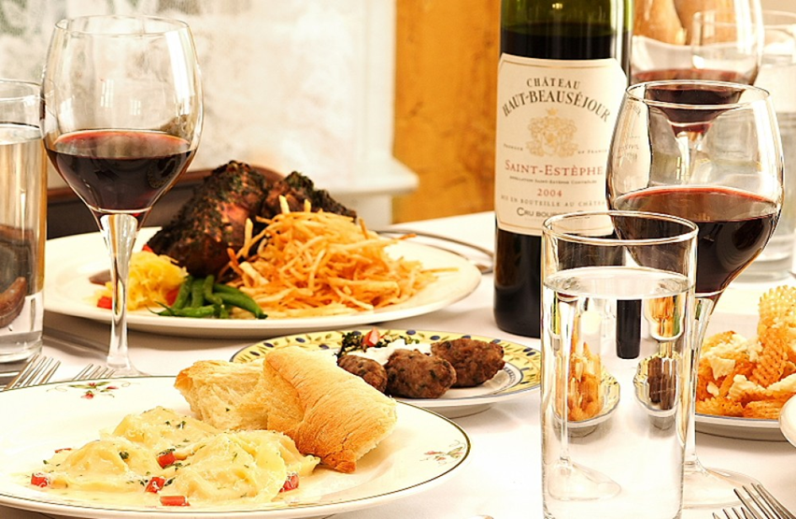
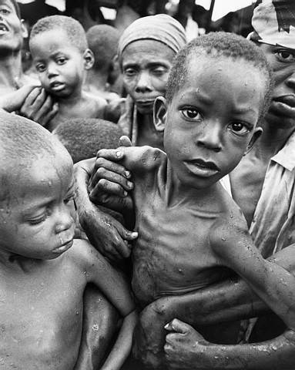
Have a heart
Non-GMO is a Western indulgence of the rich
It doesn’t work for the poor in Africa who don’t ask
What will I eat today?
They ask Will I eat today?

Slide 25
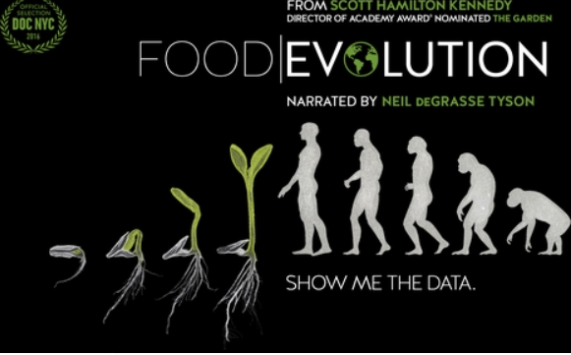
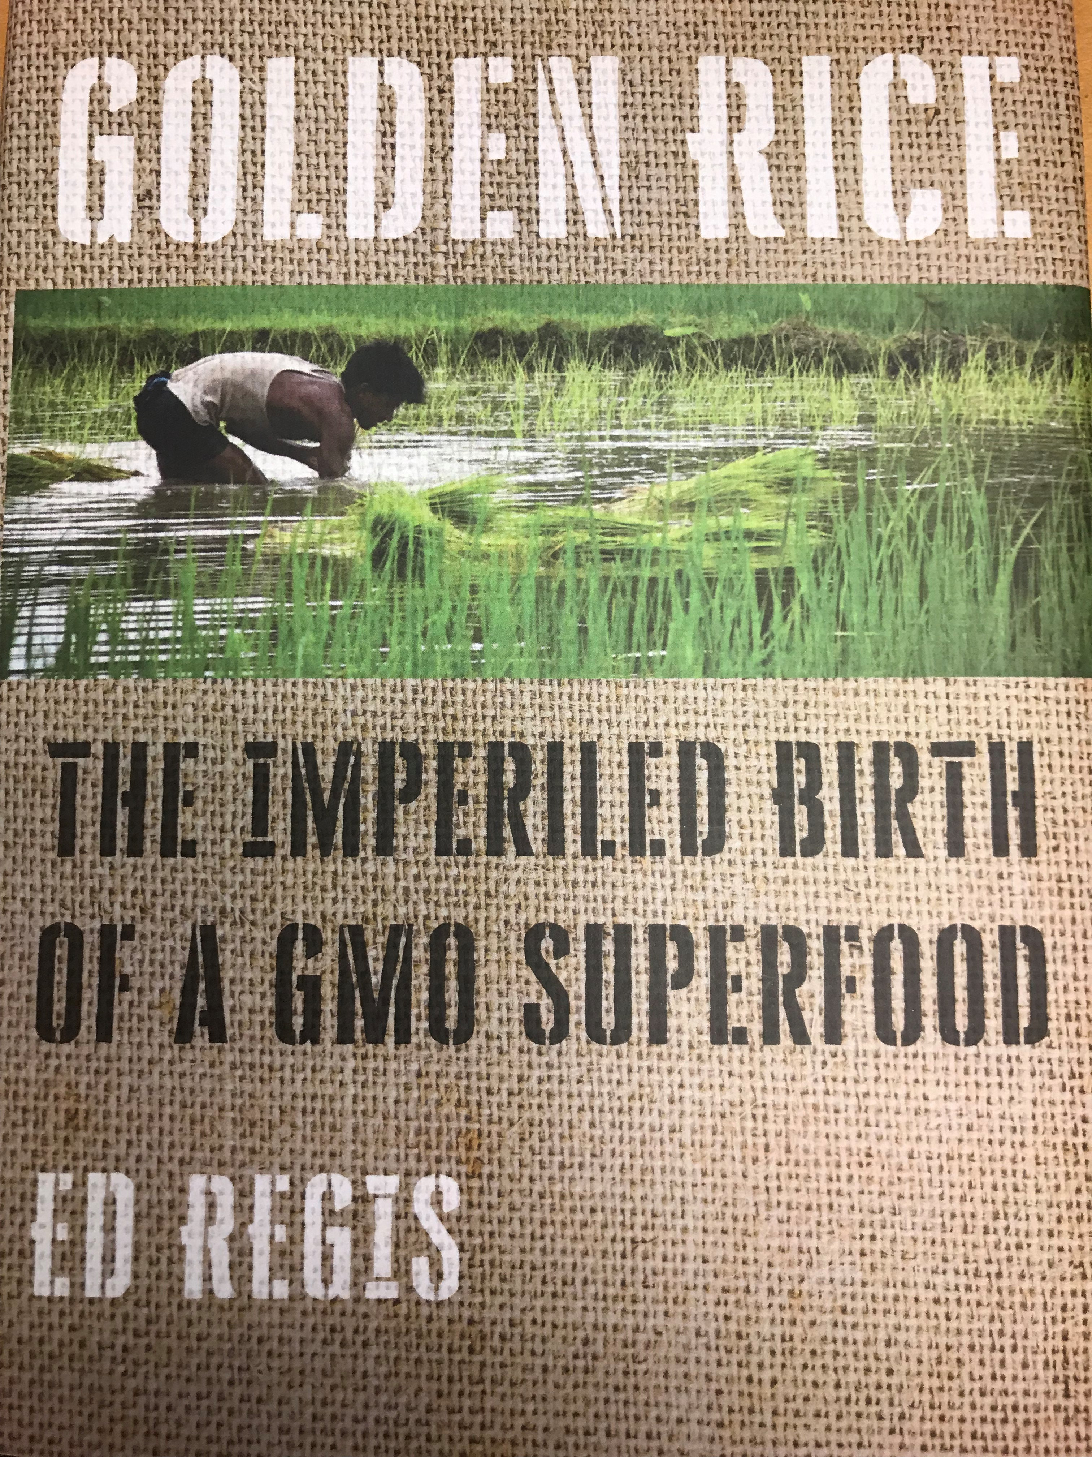
http://supportprecisionagriculture.org/

