Slide 1
144 Nobel Laureates support GMOs
Richard J. Roberts
Africa Food Security
Kigali, August 5, 2019

Slide 2
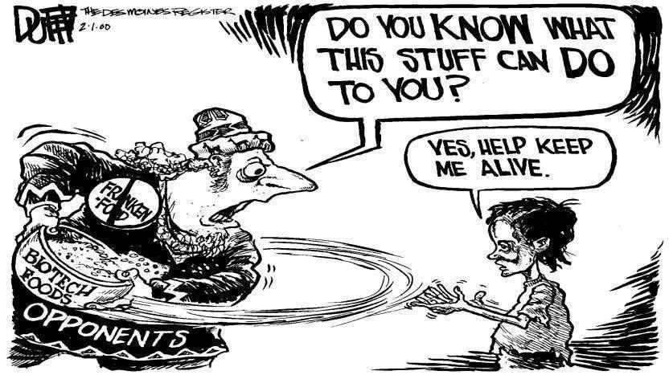
144 Nobel Laureates are urging everyone to acknowledge that GMO technology is basically safe and should be supported and encouraged for the sake of the developing world, who desperately need better yielding crops with added nutritional value.
http://supportprecisionagriculture.org/

Slide 3
Remember that for the 800 million who go to bed hungry at night
FOOD is MEDICINE

Slide 4
Food means Agriculture
For 10-12,000 years we had been using crude genetics
But in the 1980’s we learned how to be precise

Slide 5
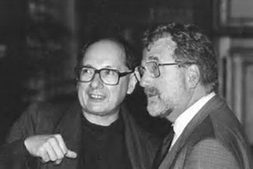
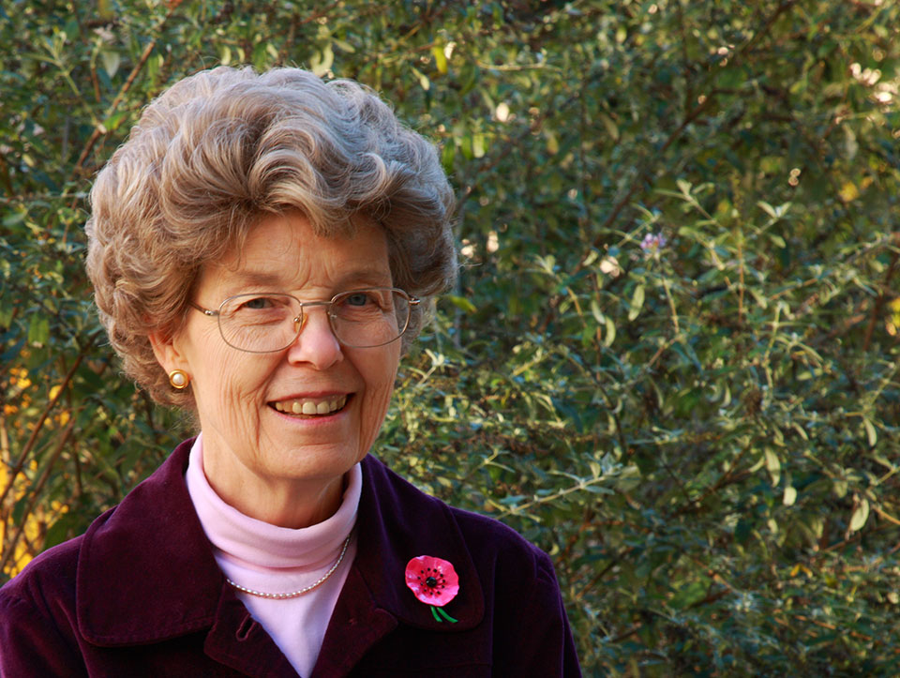
Marc Van Montagu and Jeff Schell
discoverers of Ti plasmid transformation
also independently, Mary Dell Chilton

Slide 6
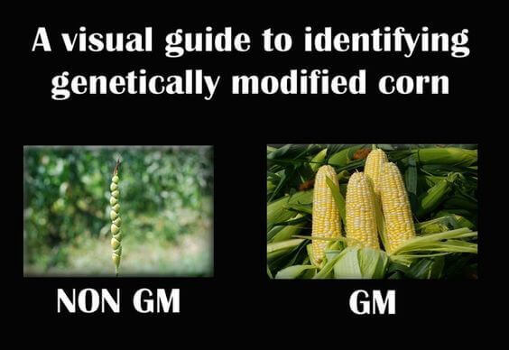
Teosinte
the wild ancestor
GM by Nature
Modern corn
In our supermarkets
GM by man

Slide 7
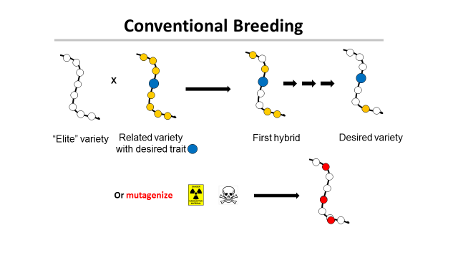
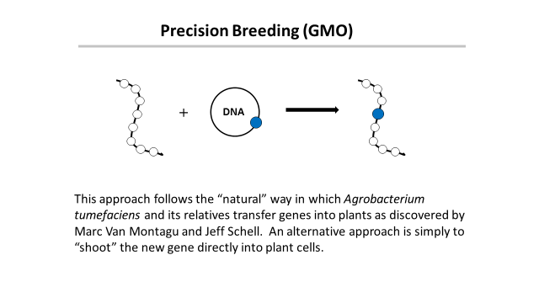
‘This is safe!’
← Greenpeace claims →
‘This is dangerous!’

Slide 8
Traditional versus precision methods
I want to move a GPS system from my old car into my new one
Should I disassemble the two cars, mix up the parts and then “select” for the one with the GPS, ignoring what else it might have picked up?
Or should I take the GPS from one car and move it to the other?

Slide 9
Traditional versus precision methods
If I take a GPS from an airplane
will the new car fly?

Slide 10
Genetic Modification refers to a method
But what is important is the
PRODUCT
not the
METHOD
This is just as true for traditional breeding

Slide 11
Plants can’t run away from predators
So how do they protect themselves?
With pesticides!

Slide 12
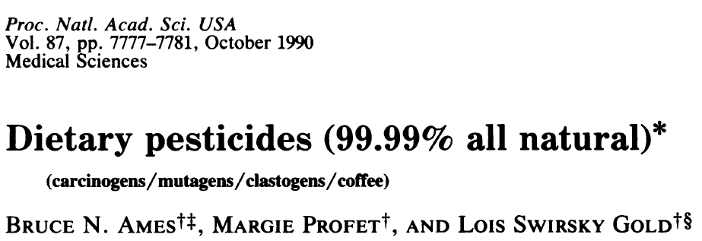
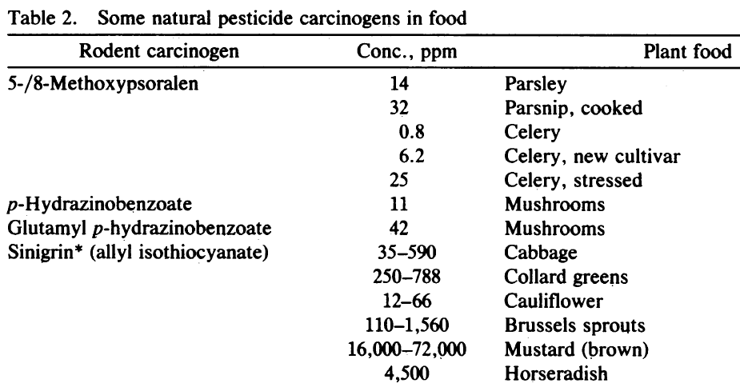
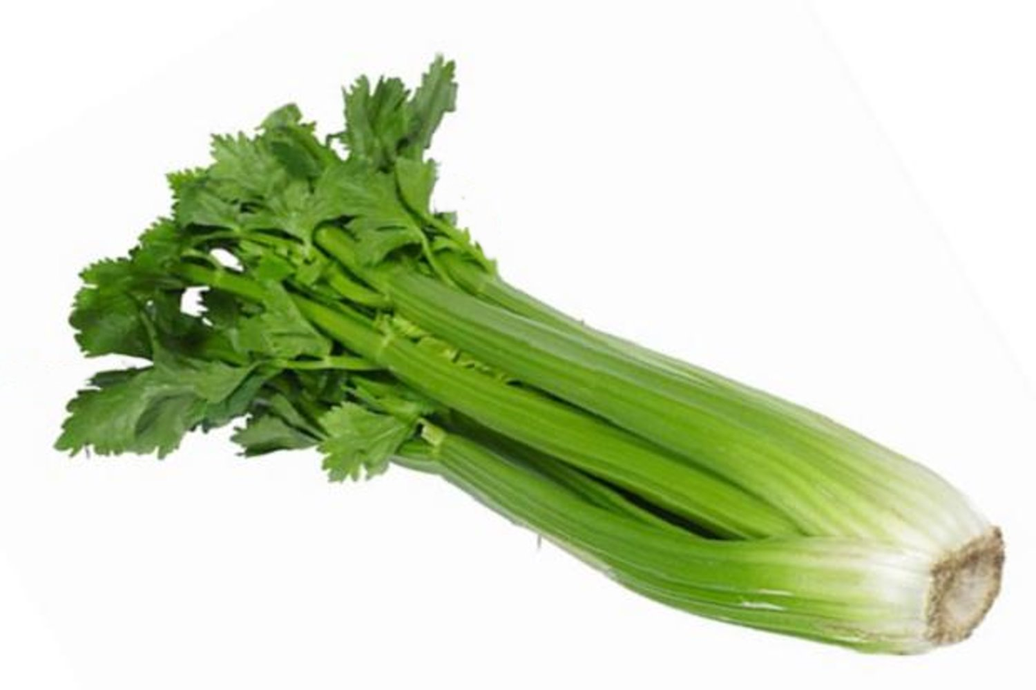
Many common vegetables have high levels of natural pesticides.
+ 11 more

Slide 13
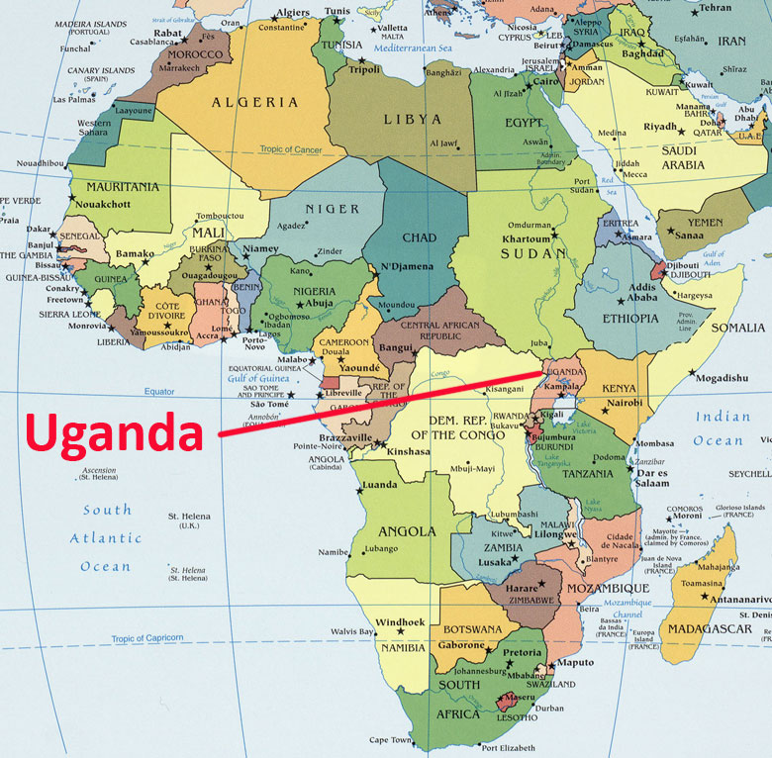
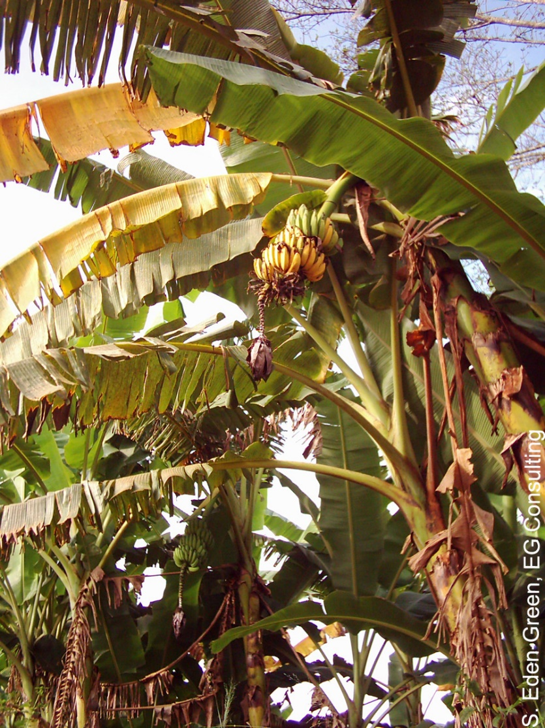
The Banana Problem
Xanthomonas wilt
No natural varieties are resistant so no
traditional breeding solution
BUT
Sweet pepper is resistant to Xanthomonas campestris and two genes are known that mediate this resistance. Using precision techniques these genes have been transferred to banana and these modified bananas are now beginning field trials.

Slide 15
A case study in nutrition
Vitamin A-deficiency
Global population mortality (in millions)
Vitamin A-deficiency | 1.9-2.7
HIV/Aids | 1.7
Tuberculosis | 1.4
Malaria | 0.75
*Courtesy of Ingo Potrykus
Notes:
Golden Rice and Beyond – challenges of a humanitarian GMO project.

Slide 16
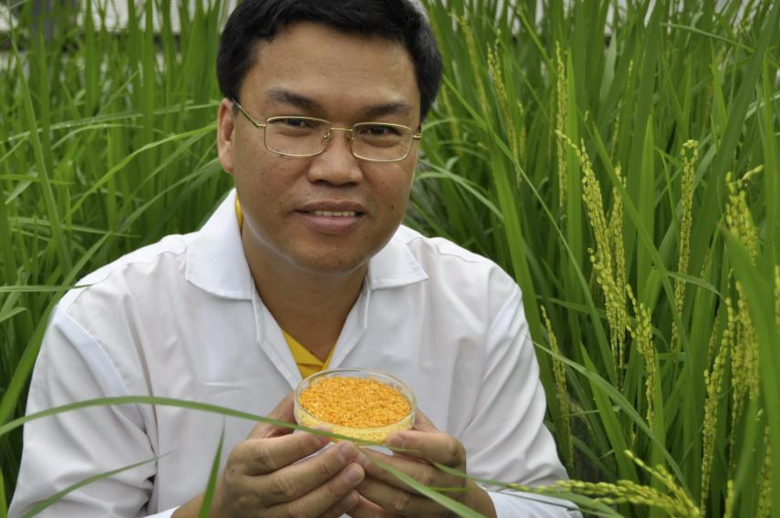
Golden Rice
A new source of Vitamin A
Ingo Potrykus, ETH Zurich
Peter Beyer, U. Freiburg
Introduce the genes for
β-carotene into rice
Courtesy of Ingo Potrykus

Slide 17
Golden Rice
Became a reality in February, 1999.
Could have been in the field within 2-5 years, beginning to save children from blindness and death.
But it’s a GMO and only now will it soon be available in Bangladesh.
Why?
Multiple years of delay due to regulation and opposition.
Courtesy of Ingo Potrykus
Notes:
Golden Rice and Beyond – challenges of a humanitarian GMO project.

Slide 18
Science Facts
For developed countries food is not a problem.
We must never forget the consequences of our actions for the developing countries
We need more science in politics
And less politics in science

Slide 19
News from Ghana: The former leader of the Peasant Farmers’ Association, Ghana’s primary anti-GMO farmers group, has switched sides to adopt a pro-GMO position.
Mohammed Adams Nasiru attributed his shift to receiving accurate information on agricultural biotechnology from the scientific community.

Slide 20
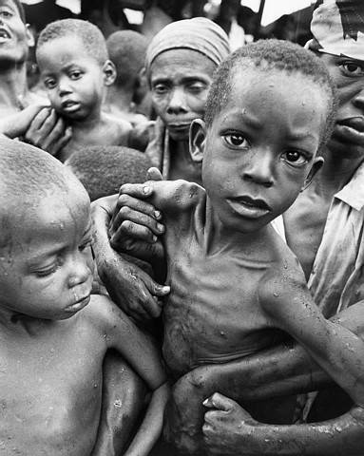
Have a heart
Non-GMO is a Western indulgence of the rich
It doesn’t work for the poor in Africa
http://supportprecisionagriculture.org/

