Slide 1


Fact and Fiction about GMOs
and the Future of Biotechnology
Richard J. Roberts
ASEPELT Congress, Acalá, Spain, June 27th 2025

Slide 2
Climate change is devastating life as we know it
Greenhouse gas emissions are a major problem
BIOENGINEERED CROPS can HELP
For the >800 million who go to bed hungry at night
FOOD is MEDICINE

Slide 3
The term Genetically Modified Organism is misleading
Every life form on this planet has been
genetically modified
by evolution
Plant and animal breeding has been practiced for centuries and involves
genetic modification.

Slide 4
Hypocrisy abounds within the anti-GMO movement
Why don’t they stop human insulin production for diabetics?
Why do they accept vaccines for COVID-19 within 12 months of development?
Why do they allow millions of tons of GMO products to be used to feed animals for human consumption?

Slide 5
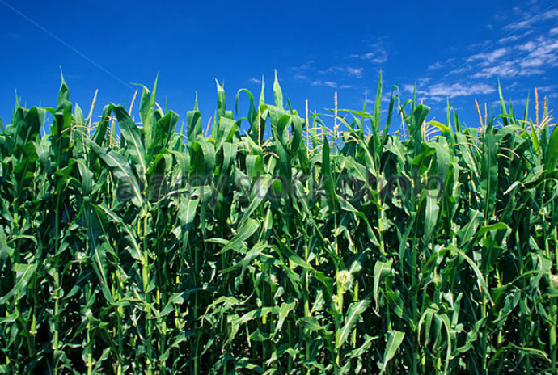
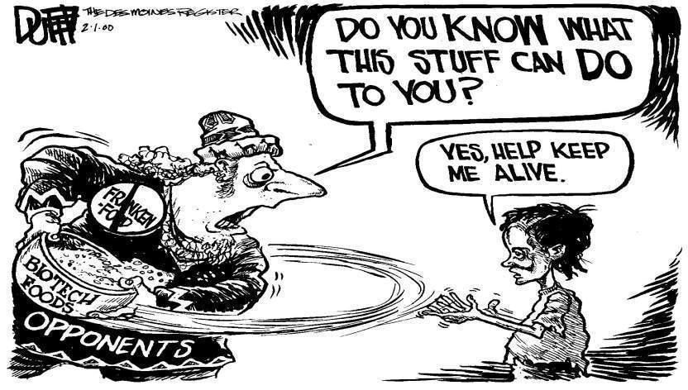
180 Nobel Laureates have supported an open letter to Greenpeace and every UN Ambassador urging an acknowledgment that GMO technology is basically safe and should be supported for the sake of the developing world, who desperately need better yielding crops with added nutritional value.
https://supportprecisionagriculture.org/

Slide 6
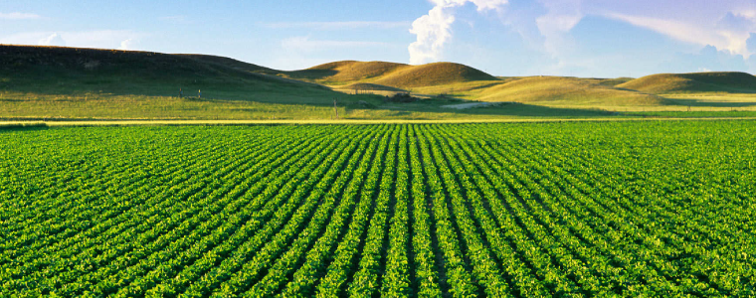
Food means Agriculture
For 10,000 -12,000 years we had been using crude genetics
But in the 1980’s we learned how to be precise

Slide 7
Plant Breeding Methods
Traditional breeding - 50/50 mixture of genes
Original GMO method – one or more known genes inserted into the
plant genome at unknown locations
3. CRISPR methods
    specific cleavage at known locations to delete genes or
    make specific mutations = to traditional methods
    b) cleave at a known location and insert a specific gene

Slide 8
Traditional versus precision methods
I want to move a GPS system from my old car into my new one
Should I disassemble two cars, mix up the parts and then “select” for the one with the GPS, ignoring what else it might have picked up?
Or should I take the GPS from one car and move it to the other?

Slide 9

Traditional versus precision methods
If I take a GPS from an airplane
will the new car fly?

Slide 10
Genetic Modification refers to a method
But what is important is the
PRODUCT
not the
METHOD
This is just as true for traditional breeding

Slide 11
Plants can’t run away from predators
So how do they protect themselves?
With pesticides!

Slide 12
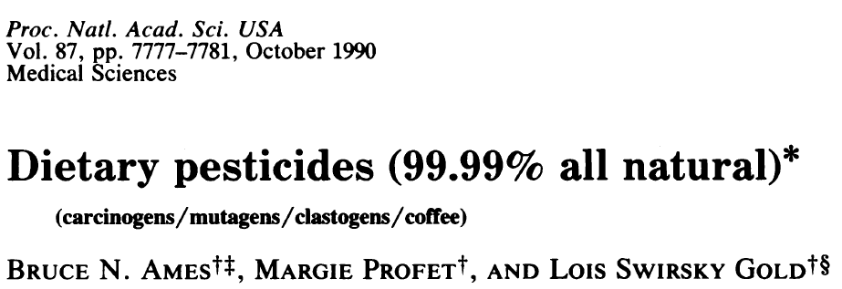
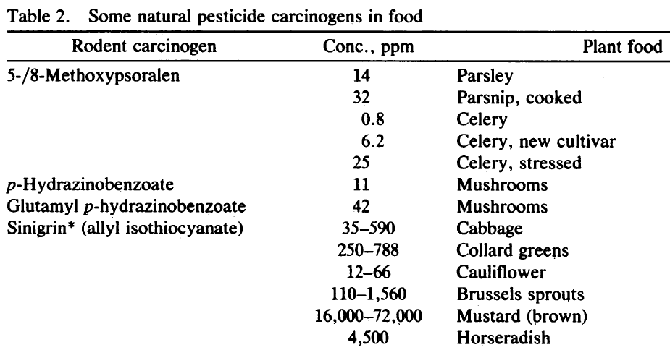
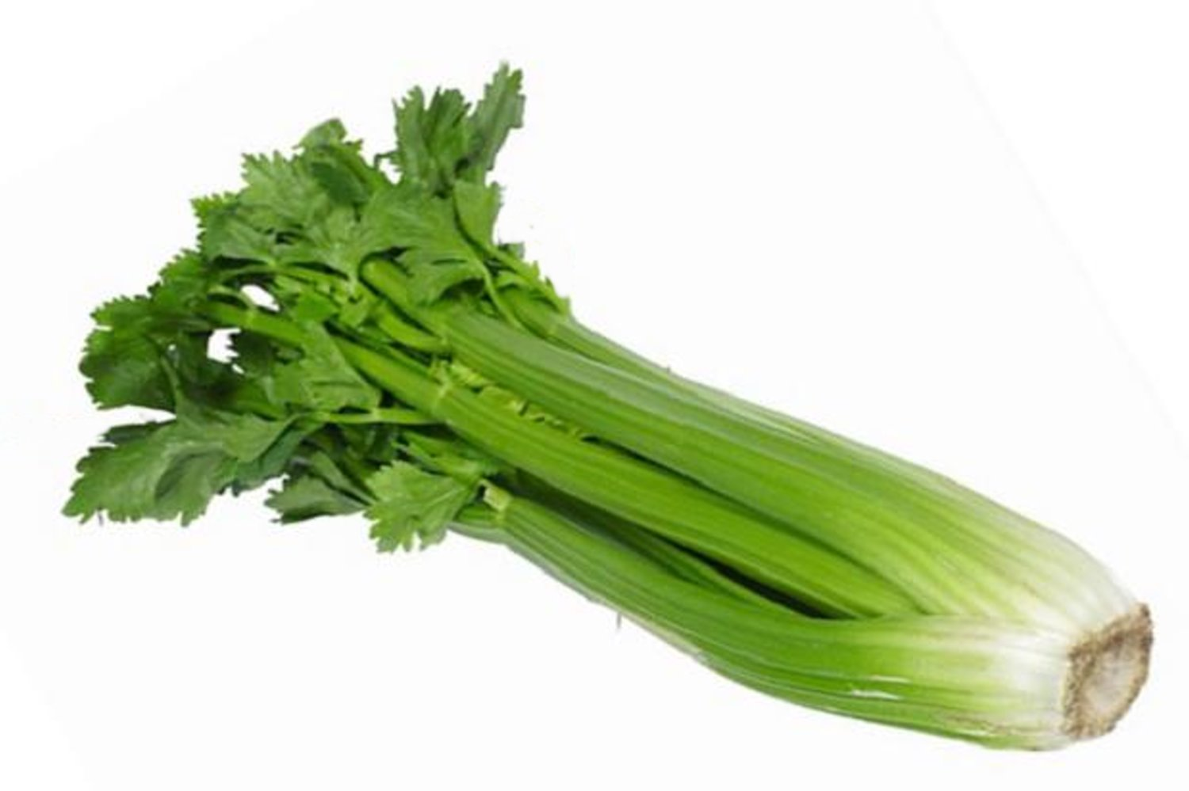
Many common vegetables have high levels of natural pesticides
.

Slide 13

Food in Developing Countries
Africa, S. America, Asia need better crops with higher yields.
They need the products of precision breeding
Europe doesn’t
So why doesn’t Europe endorse this?

Slide 14
The Real Problem
Could it be politics, or money or both?
Europeans did not want US companies to control their food
How can that be prevented?
Ban Monsanto and the other big US agribusinesses

Slide 15
The Green Parties Solution
Assert that GMO methods might be dangerous!
The politicians and the green parties will protect
you from this risk by banning GMOs
Best of all
This has no economic consequence for Europe !

Slide 16
The Precautionary Principle
If innovation might cause harm and there is no proof that it is safe
Wait until scientific evidence is available
But how much evidence is enough?
Insulin for diabetics, cheese, wine, bread
Vaccines for COVID-19
Cell phones

Slide 17
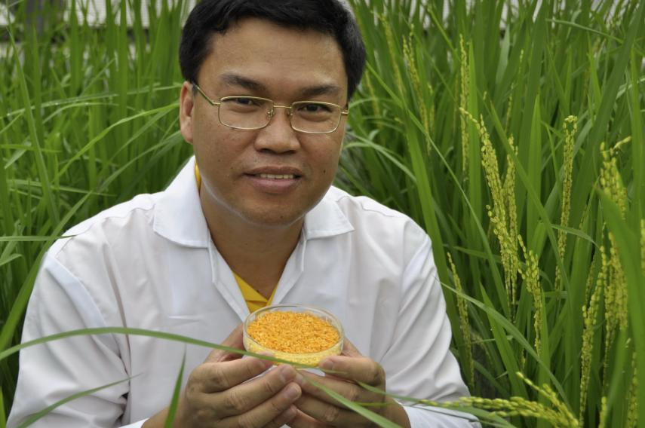
Golden Rice
A new source of Vitamin A
Suggested by Peter Jennings in 1984
Brought to fruition by
Ingo Potrykus, ETH Zurich
Peter Beyer, U. Freiburg
Tony Alfonso
Courtesy of Ingo Potrykus

Slide 18
Golden Rice
Became a reality in February, 1999.
Could have begun the improvements necessary for commercial production in the field within 2-5 years
But it’s a ‘GMO’ and was only recently made available in the Philippines
And now the Green Parties are trying to stop it again
Multiple years of delay due to regulation and opposition.
Courtesy of Ingo Potrykus
Notes:
Golden Rice and Beyond – challenges of a humanitarian GMO project.

Slide 19

Science Fiction
Greenpeace blocks development
And then claims
It has taken so long it can’t possibly work!

Slide 20
Since 2005 millions of children have died or suffered because of Vitamin A deficiency
How many must die before we consider this a “crime against humanity”?

Slide 21
Some positive examples of common sense
Bt Brinjal approved in Bangladesh
Bt Cotton approved in many countries
Bt corn approved in many countries
Rainbow papaya approved in the US
GMO mustard approved in India
Bt Cowpea approved in Nigeria
Golden Rice approved in the Philippines, then stopped

Slide 22
GMO crops under development
Bananas Kenya/Uganda
Casava Kenya/Uganda
Drought-resistant Wheat many countries
Increased protein content of Sorghum Australia
More nutritious Tomatoes Japan
Increased yield for Alfalfa Argentina
Herbicide tolerant Oilseed Rape China
+ hundreds more

Slide 23
Food choice is a luxury of the developed world
If you don’t want to eat foods derived by GM techniques, then don’t. It’s your choice
But don’t pretend such foods are dangerous
If anything
They are probably safer than traditional foods

Slide 24
Science Facts
For developed countries food is not a problem.
We must never forget the consequences of our actions for the developing countries
We need more science in politics
And less politics in science

Slide 25
Actions needed around the world
Politicians should listen to the scientists they fund
Stop supporting the idea that foods produced by modern breeding methods must be inherently more dangerous than traditional methods, when science shows they are not

Slide 26
Civil Society must play its role too
The major religious leaders should speak out
Groups such as the Rotary Clubs should speak out
Influential celebrities should speak out
The media should present science facts not science fiction

Slide 27
CONGREGATION FOR DIVINE WORSHIP
AND THE DISCIPLINE OF THE SACRAMENTS
Prot. N. 320/17
Circular letter to Bishops
on the bread and wine for the Eucharist
.
.
.
.
5. The same Congregation also decided that Eucharistic matter made with genetically modified organisms can be considered valid matter (cf. Letter to the Prefect of the Congregation for Divine Worship and the Discipline of the Sacraments, 9 December 2013, Prot. N. 89/78 – 44897).

Slide 28
Some positive signs
Finland’s Green Party supports GMOs
England relaxes regulations on GMO production
Öko-Progressives Netzwerk in Germany supports evidence-based legislation
Gene-edited crops now face relaxed regulation in many countries
46 countries now have official approval for at least one GMO crop
Europeans are increasingly concerned about diminished crop yields
Soybean around the world is almost all GMO – extensive use for animal feed

Slide 29
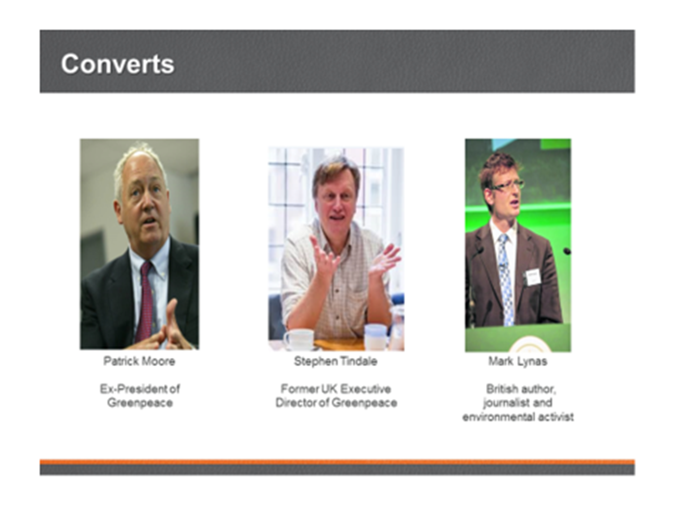
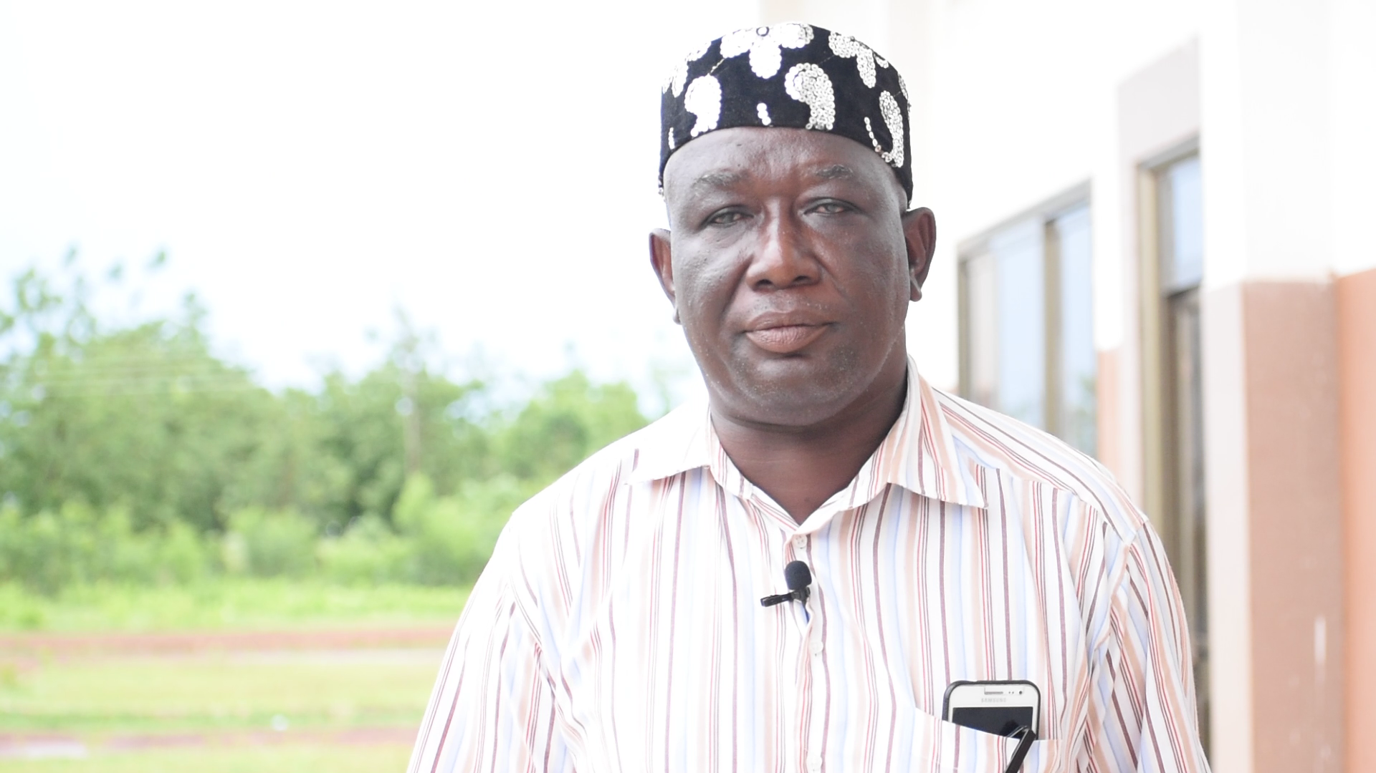
News from Ghana: The former leader of the Peasant Farmers’ Association, Ghana’s primary anti-GMO farmers group, has switched sides to adopt a pro-GMO position.
Mohammed Adams Nasiru attributed his shift to receiving accurate information on agricultural biotechnology from the scientific community.

Slide 30

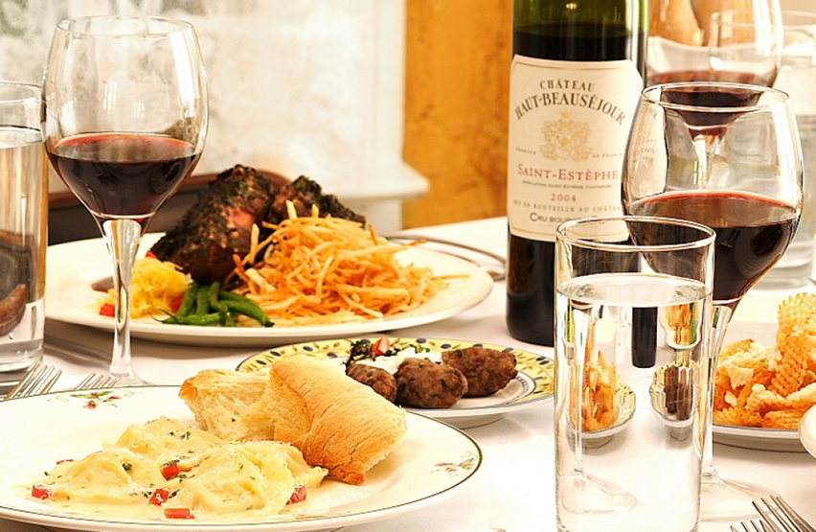
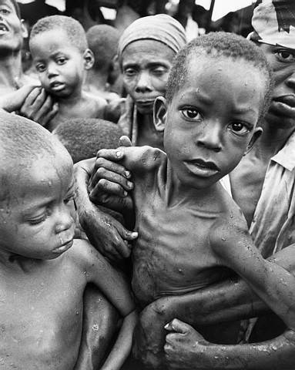
Have a heart
Non-GMO is a Western indulgence of the rich
It doesn’t work for the poor in Africa who ask
Will I eat today?
Not, What will I eat today?

Slide 31
Join us
http://supportprecisionagriculture.org/
Roberts, R. J.; Naimy, V. Overcoming Agricultural Challenges with GMOs as a Catalyst for Poverty Reduction and Sustainability in Lebanon. (2023).

