Slide 1
Why should we trust science?
Richard J. Roberts
Webinar – September 30th 2021
http://supportprecisionagriculture.org/

Slide 2
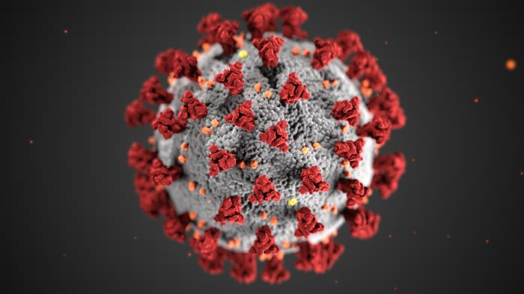
Frankenfood
GMOs
Misinformation
Origins
Safety
World impact
Covid-19
Tests
Vaccines
Origin

Slide 3
COVID-19 Tests
RNA tests
PCR (Polymerase Chain Reaction)
LAMP (Loop-mediated isothermal amplification)
Antibody tests
COVID-19 antigen detection using antibodies
Nasal swabs or spit in a tube

Slide 4
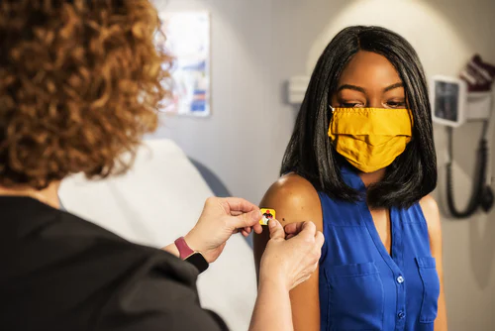
Vaccines
Traditional antigen-based vaccines
mRNA vaccines

Slide 5
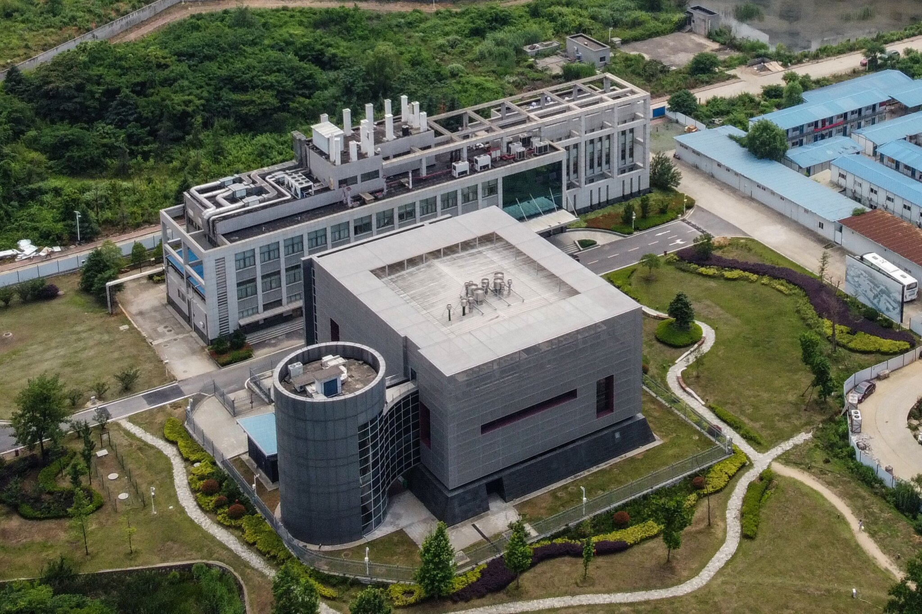
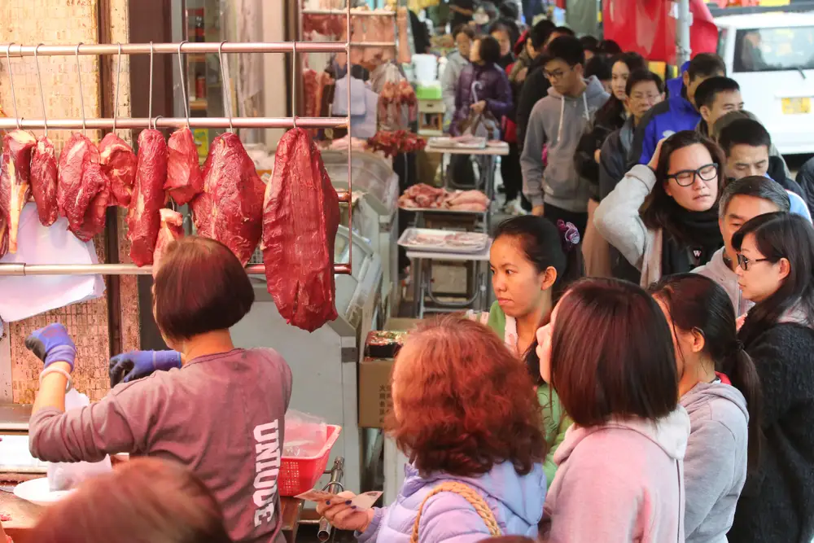
Wuhan Institute of Virology
Origin of COVID-19
Natural origin
transmission from bats via an intermediate host
Lab-leak theory
Accidental release
Deliberate manufacture

Slide 6
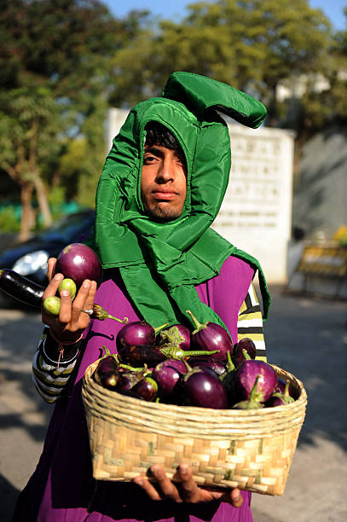
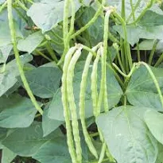
The term Genetically Modified Organism is misleading
Every life form on this planet has been genetically modified by evolution
Plant breeding has been practiced for centuries and involves genetic modification.

Slide 7
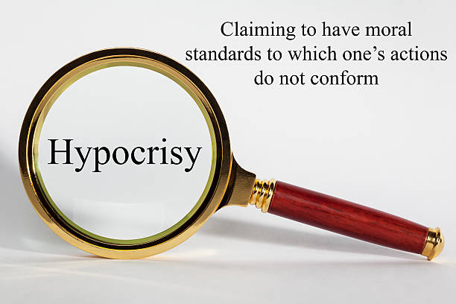
Hypocrisy abounds with the anti-GMO movement
Why don’t they stop insulin production for diabetics?
Why do they accept vaccines for COVID-19 within 12 months of development?
Why do they allow millions of tons of GMO products to be used to feed animals for human consumption?

Slide 8
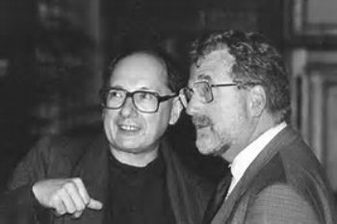
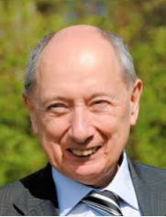
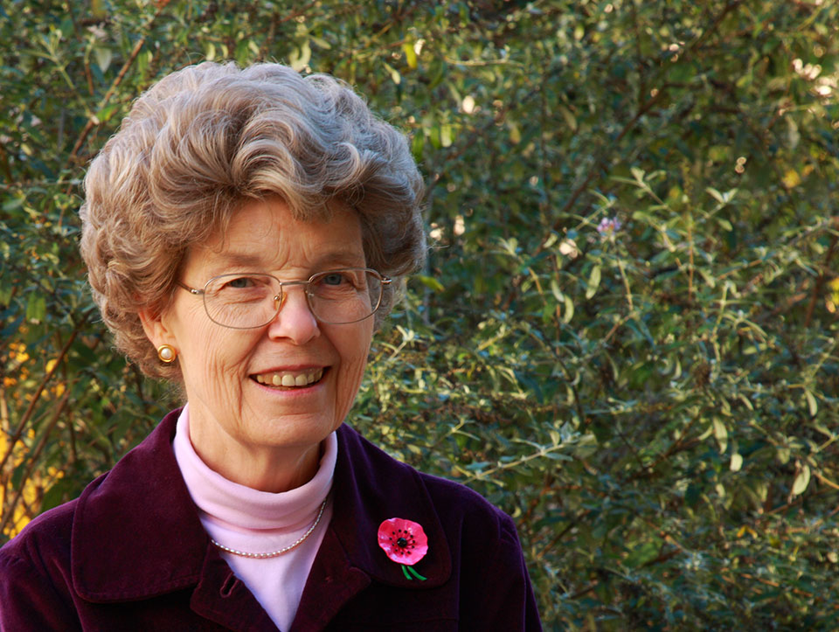
The discovery of the GMO method
Marc Van Montagu and Jeff Schell
Discoverers of Ti plasmid transformation
in 1980 together with Mary Dell Chilton

Slide 9
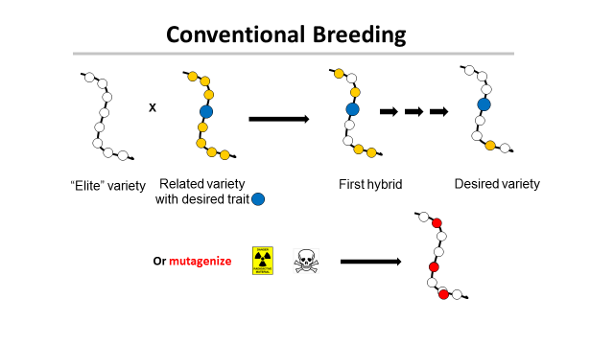
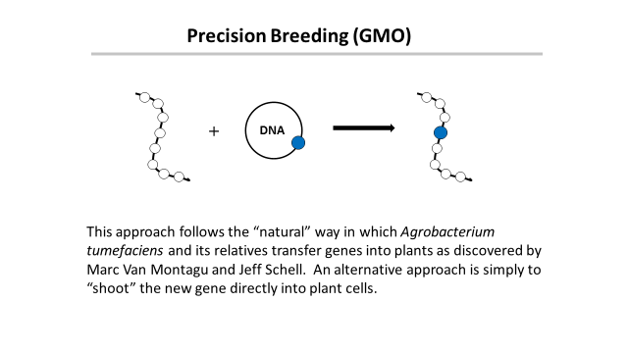
‘This is safe!’
← Greenpeace says →
‘This is dangerous!’

Slide 10
Traditional versus precision methods
I want to move a GPS system from my old car into my new one
Should I disassemble two cars, mix up the parts and then “select” for the one with the GPS, ignoring what else it might have picked up?
Or should I take the GPS from one car and move it to the other?

Slide 11
Traditional versus precision methods
If I take a GPS from an airplane
will the new car fly?

Slide 12
Genetic Modification refers to a method
But what is important is the
PRODUCT
not the
METHOD
This is just as true for traditional breeding

Slide 13
Remember that for the 800 million who go to bed hungry at night
FOOD is MEDICINE

Slide 14
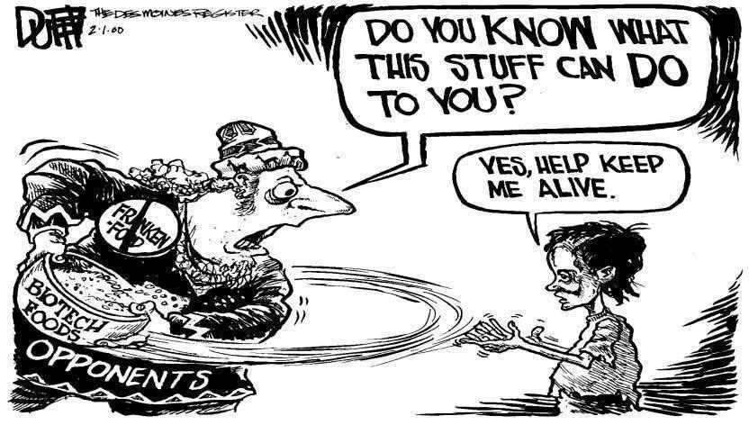
158 Nobel Laureates have supported an open letter to Greenpeace and every UN Ambassador urging an acknowledgment that GMO technology is basically safe and should be supported for the sake of the developing world, who desperately need better yielding crops with added nutritional value.
http://supportprecisionagriculture.org/

Slide 15
The origins of the anti-GMO movement
Africa, S. America, Asia need better crops with higher yields.
They need the products of precision breeding
Europe doesn’t
So why doesn’t Europe endorse this?
Could it be politics, or money or both?

Slide 16
The Real Problem
Europeans did not want US companies to control their food
How can that be prevented?
Ban Monsanto and the other big US agribusinesses
Not so fast - the farmers buy their seeds from them

Slide 17
The Green Parties Solution
Assert that precision breeding might be dangerous!
The politicians and the green parties will protect
you from this risk by banning GMOs
Best of all
This has no economic consequence for Europe,
but excellent economic consequences for Greenpeace !

Slide 18
A case study
Vitamin A-deficiency
Global population mortality (in millions)
Vitamin A-deficiency | 1.9-2.7
HIV/Aids | 1.7
Tuberculosis | 1.4
Malaria | 0.75
*Courtesy of Ingo Potrykus
Notes:
Golden Rice and Beyond – challenges of a humanitarian GMO project.

Slide 19
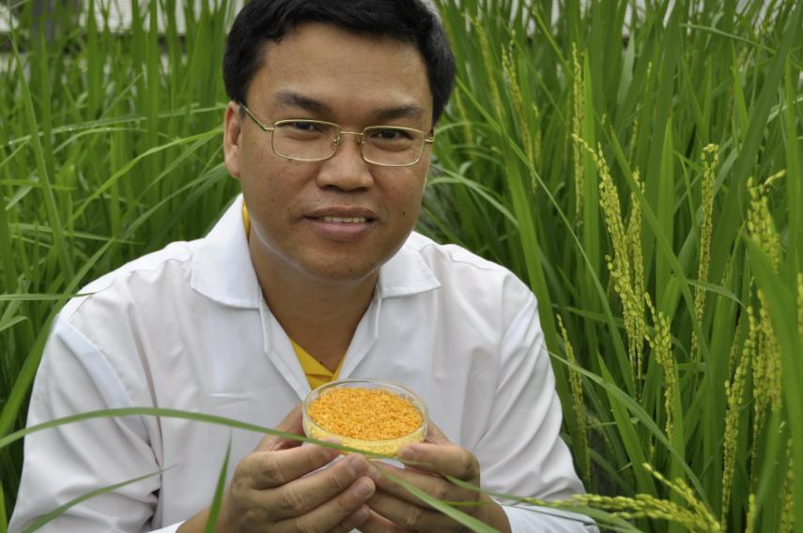
Golden Rice
A new source of Vitamin A
Suggested by Peter Jennings in 1984
Brought to fruition by
Ingo Potrykus, ETH Zurich
Peter Beyer, U. Freiburg
Tony Alfonso
Courtesy of Ingo Potrykus

Slide 20
Golden Rice
Became a reality in February, 1999.
Could have begun the improvements necessary for
commercial production in the field within 2-5 years
But it’s a ‘GMO’ and only three months ago did it become available for commerical production (in the Philippines)
Multiple years of delay due to regulation and opposition.
Courtesy of Ingo Potrykus
Notes:
Golden Rice and Beyond – challenges of a humanitarian GMO project.

Slide 21
Food choice is a luxury of the developed world
If you don’t want to eat foods derived by GM techniques, then don’t. It’s your choice
But please don’t pretend such foods are dangerous
If anything
They are probably safer than traditional foods

Slide 22
Science Facts
For developed countries food is not a problem.
We must never forget the consequences of our actions for the developing countries
We need more science in politics
And less politics in science

Slide 23
Civil Society must play its role too
The major religious leaders should speak out
Groups such as the Rotary Clubs should speak out
Influential celebrities should speak out
The media should present science facts not science fiction

Slide 24
Some important numbers about GMOs
37% - decrease in pesticide use in the US
22% - increase in crop yields
27 - million tonnes of GM soy imported into the EU every year
0 - problems scientifically attributable to GM crops

Slide 25
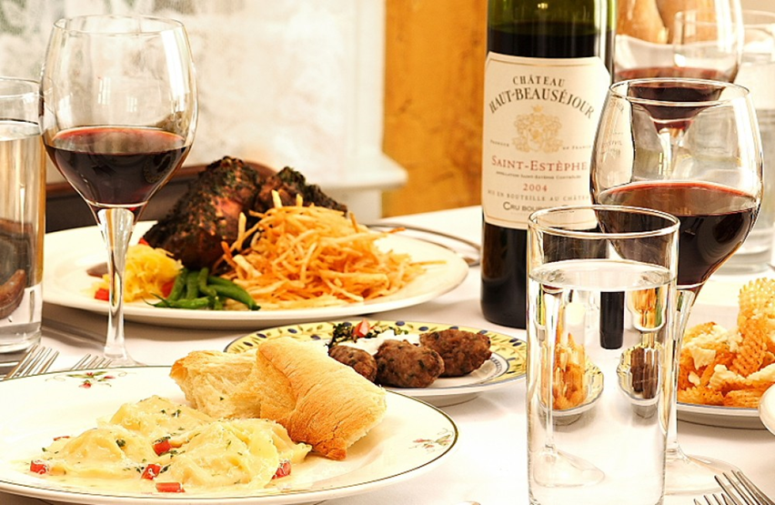
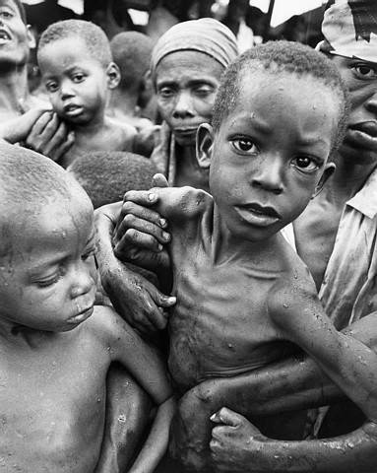
Have a heart
Non-GMO is a Western indulgence of the rich
It doesn’t work for the poor in Africa who ask
Will I eat today?
Not, What will I eat today?

Slide 26
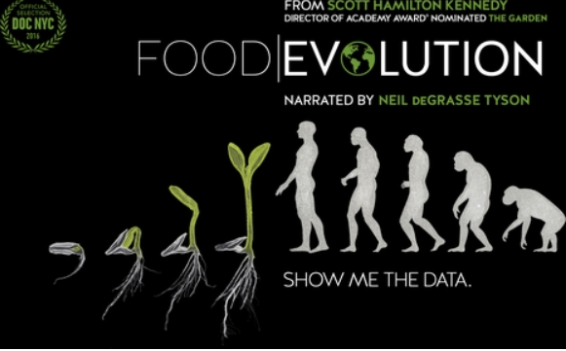
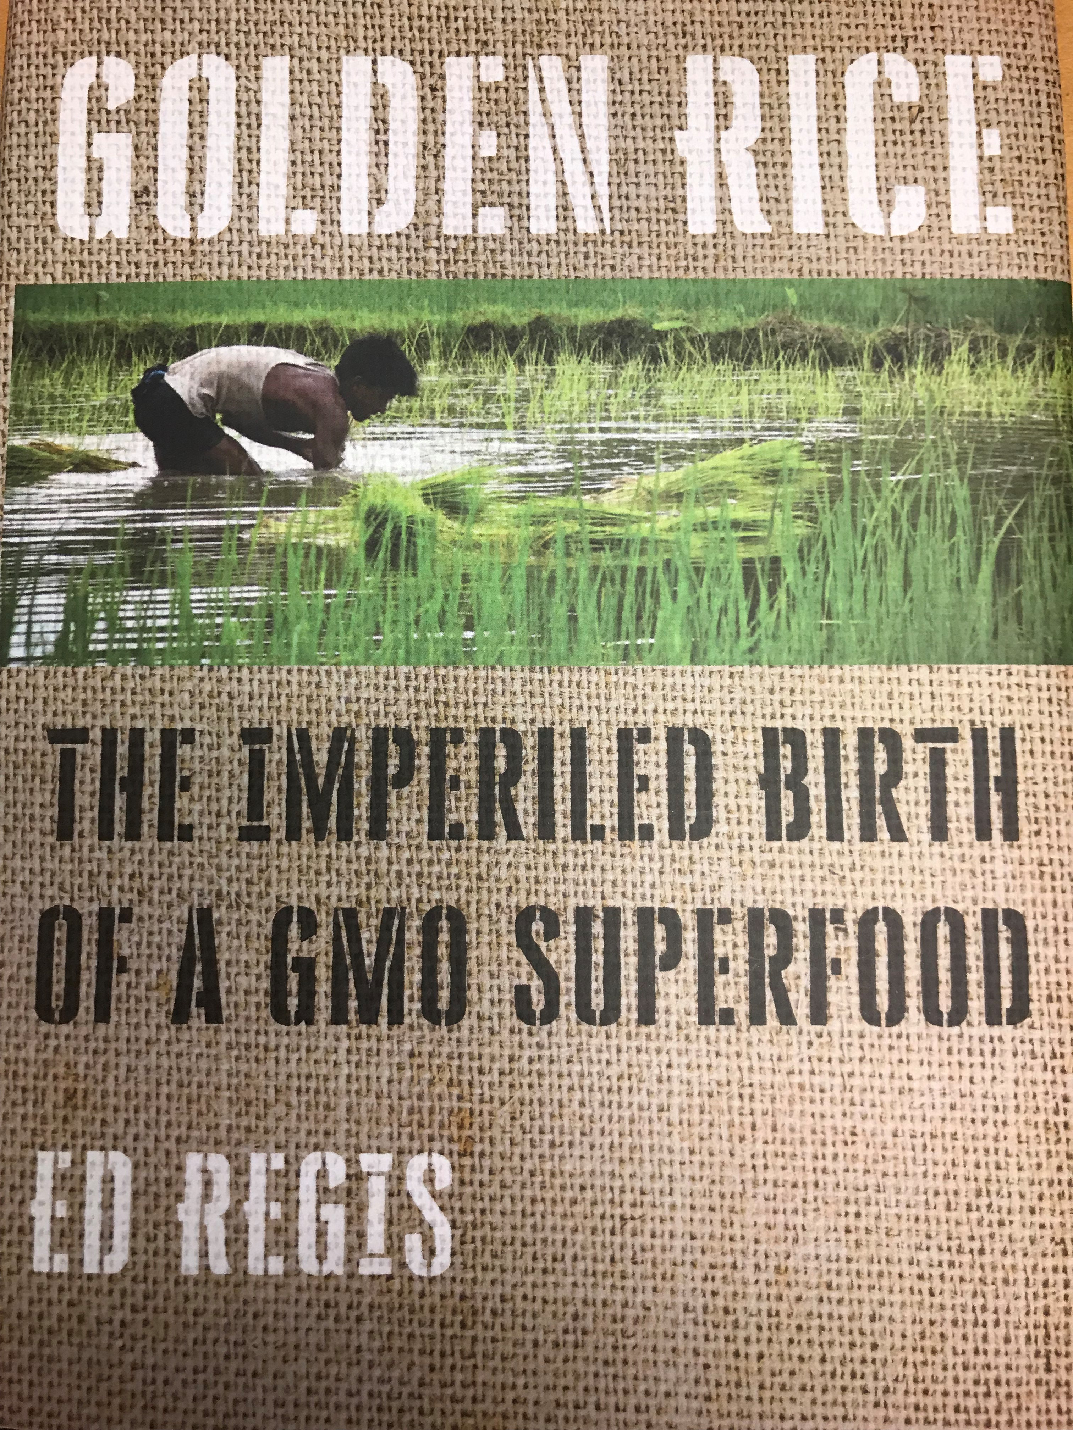
http://supportprecisionagriculture.org/

